Slide 1

Set Theory
By Ariel Avshalom
Lecture 2
CISC 2210

Slide 2

What we’ll cover:
Sections 2.2, 2.3, 2.4 of the book: https://www.people.vcu.edu/~rhammack/Discrete/Alpha.pdf

Slide 3

The cartesian product
What does it mean to multiply a group of sets?
How do the properties of the new object differ?

Slide 4
A x B
Given two sets A and B, we can “multiply them to produce a new set called A x B.
This new set’s elements is comprised of ordered pairs.

Slide 5
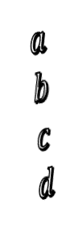
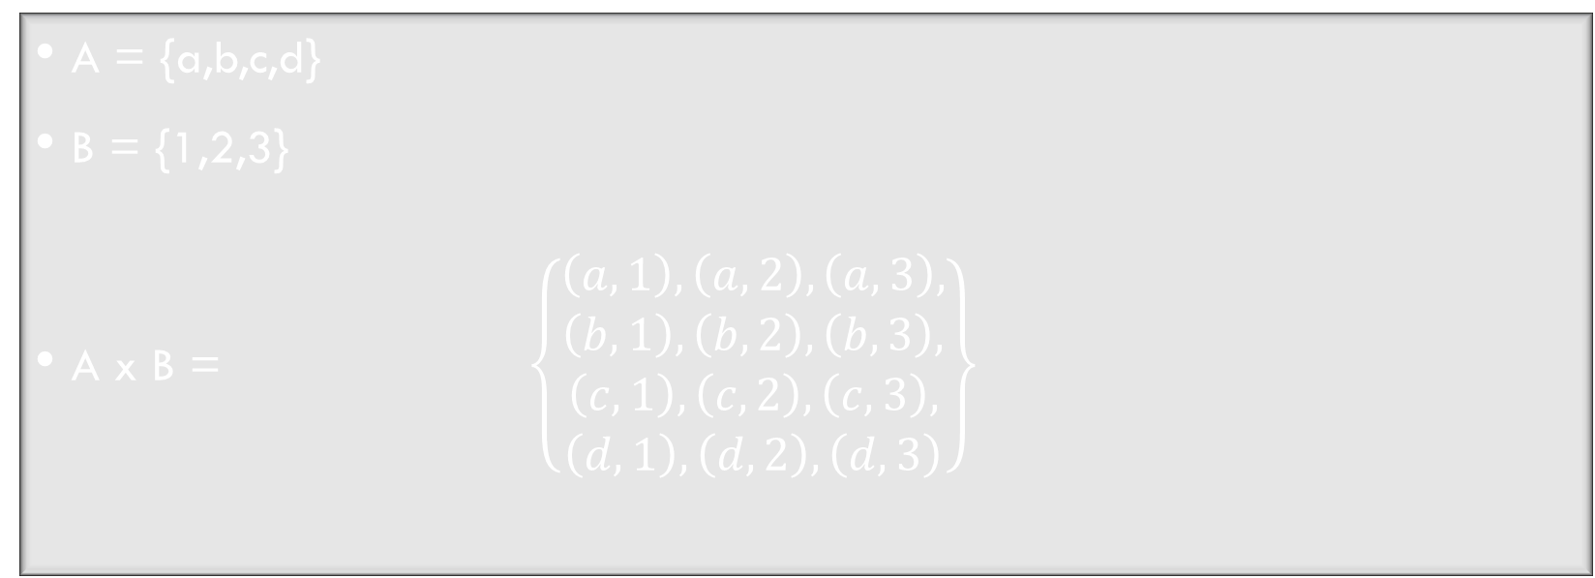
Example:
A = {a,b,c,d}
B = {1,2,3}
A x B = $\left\{\begin{aligned}\left(a,1\right),\left(a,2\right),\left(a,3\right), \\ \begin{aligned}\left(b,1\right),\left(b,2\right),\left(b,3\right), \\ \begin{aligned}\left(c,1\right),\left(c,2\right),\left(c,3\right), \\ \left(d,1\right),\left(d,2\right),\left(d,3\right)\end{aligned}\end{aligned}\end{aligned}\right\}$
$$a$$
$$b$$
$$c$$
$$d$$
1 2 3

Slide 6


Important details to note:
When we have ordered pairs, we use () to denote them instead of {}.
Order matters i.e. $\left(1,x\right)≠(x,1)$
You can have an ordered pair of sets, like ({2,5},{3,2}) or (ℝ,(0,0))

Slide 7

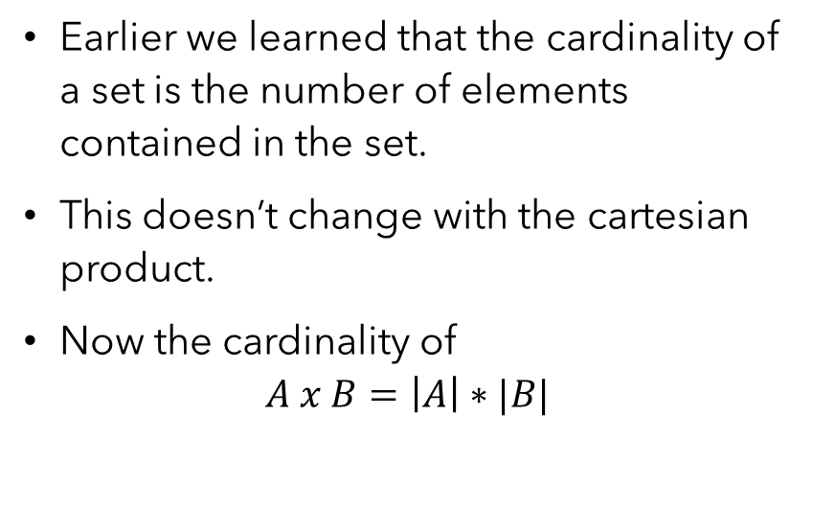
The cardinality of a cartesian product
Earlier we learned that the cardinality of a set is the number of elements contained in the set.
This doesn’t change with the cartesian product.
Now the cardinality of
$$A x B=\left|A\right|∗|B|$$

Slide 8
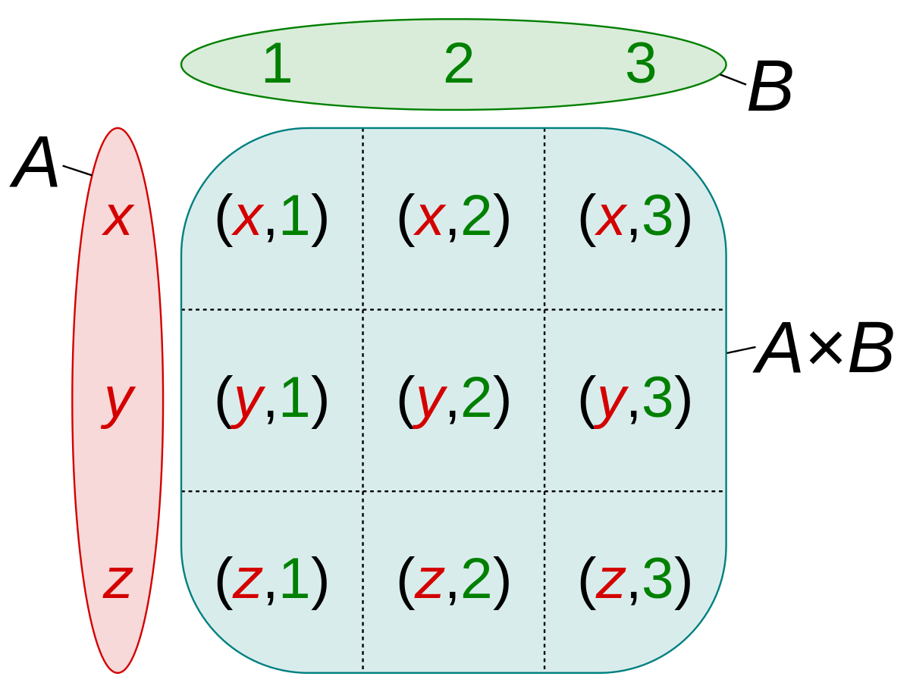
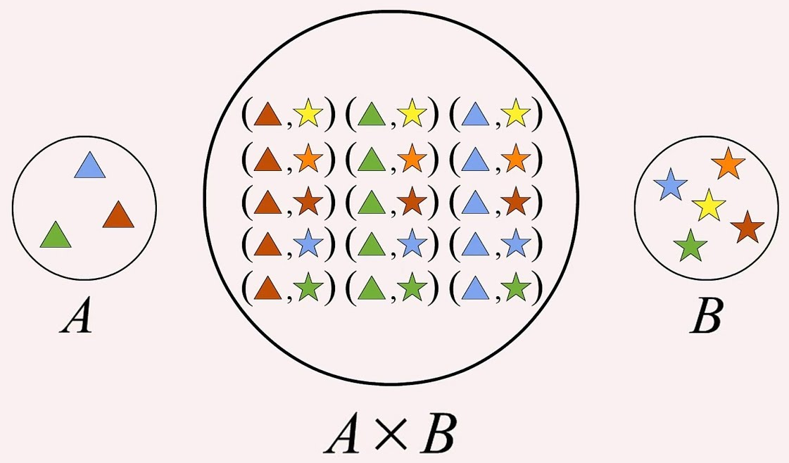
pictorial representation

Slide 9
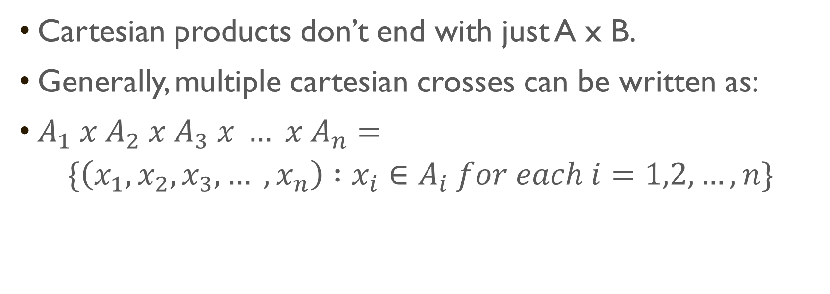
General case
Cartesian products don’t end with just A x B.
Generally, multiple cartesian crosses can be written as:
$A_{1} x A_{2} x A_{3} x … x A_{n}=$
$$\{\left(x_{1}, x_{2}, x_{3}, … ,x_{n}\right) :x_{i}∈A_{i} for each i=1,2,…,n\}$$

Slide 10

Cartesian powers
We can also represent cartesian products as powers.
Example:
$A x A x A x A =A^{4}$
And the cardinality of the above is |A|*|A|*|A|*|A| or ${|A|}^{4}$

Slide 11

Why is this important?
In H*LL
Whenever you encountered ordered pairs in math before in reality you’ve been using cartesian products.
So all of those annoying graphs you drew in the last 8+ years of your life (and the ones you’ll continue to draw) come from this idea.

Slide 12
Real world application
SQL relies heavily on crosses such as the cartesian product
Using crosses to find relations amongst data is done all the time

Slide 13


Some Examples
$A=\left\{π, e, 0\right\}$ and $B=\left\{a,c\right\}$
Find: $A^{2}, A x \text{∅}\text{, }\text{A} \text{x} \text{B} \text{x} \text{B}$
What’s the cartesian product of
$$\{n ∈\text{ℕ} \text{: 2 < }\text{n}\text{ < 5\} }\text{x}\text{ \{}\text{n} ∈\text{ℤ}\text{ : |}\text{n}\text{| = 5\}}$$

Slide 14


Subsets
When every element of a set A is contained in a set B, we say that A is a subset of B
A ⊂ B
If $A ≠B$ but A ⊂ B then we say that A is a proper subset of B
A ⊆ B
If A ⊂ B and B ⊂ A, it logically follows that A = B.
i.e. everything in A is contained in B and everything in B is contained in A.

Slide 15


The power set
If n is the cardinality of a set S, $2^{n}$ is the number of subsets contained in S
We denote the number of subsets in a set as the power set or 𝒫(set)
Example: A = {1,2,3}
|𝒫(A)| = $2^{|A|}$ = $2^{3}$ = 8
𝒫(A) = {∅, {1}, {2}, {3}, {1,2}, {1,3}, {2,3}, {1,2,3}}

Slide 16


Examples
Is $\left\{2, 3, 4\right\}\text{⊆}\text{\{1, 2, 3, 4, 5\}?}$
Is this true?
$$\text{ℕ} \text{⊆} \text{ℤ} \text{⊆} \text{ℚ} \text{⊆} \text{ℝ} \text{⊆} \text{ℂ}$$
List the subsets of:
{∅}
{{1,2},3}
{ℕ,ℚ,ℝ}

Slide 17

Power set examples
Find the
𝒫({2})
𝒫({1,{1,2}})
$𝒫(ℝ^{2})$
𝒫(𝒫({7}))
𝒫({17})x 𝒫({31})
|𝒫({17})x 𝒫({31})|

